Slide 1
Mastering Azure networking concepts – ExpressRoute and Azure Firewall
Jon Ormond, Principal PM
Azure Networking

Slide 2
Session learning objectives
Business Problems:
Contoso has a branch office where Ops Personnel need to connect to their Azure deployments.
Contoso wants to host a web site in Azure but is concerned about security both in the cloud and on-premises.
At the end of this session, you should be better able to…
discuss Azure Networking options in general
describe how virtual networks can be used, including VNet Peering
describe connectivity options from on-premises to Azure
know how to implement and configure Azure Firewall
understand and describe the three rule types associated with Azure Firewall
understand how to monitor and track events on the Azure Firewall
Notes:
Audience questions:
Who is here for ExpressRoute? (can anyone tell me what ExpressRoute is?)
Who is here for Azure Firewall? (can anyone tell me what Azure Firewall is?)
Who is here for both? You’re my people! ☺
Anything we should put in the parking lot to cover if time allows?

Slide 3
Azure PowerShell SDK Update

Slide 4
Azure PowerShell SDK - Az
Azure PowerShell SDK Module - Az
Not compatible with the older AzureRM SDK (ie can’t be installed side by side)
There is an alias set so AzureRM commands will still work
It’s not required now, but new features are going into Az only
New Azure Login Method
Connect-AzAccount
AzureRM commands should work with Enable-AzureRmAlias
https://azure.microsoft.com/blog/how-to-migrate-from-azurerm-to-az-in-azure-powershell/

Slide 5
Idempotent PowerShell Operations
# 3.3 Create Public IPs
Write-Host (Get-Date)' - ' -NoNewline
Write-Host “Creating Public IP address“ -ForegroundColor Cyan
Try {$pip = Get-AzPublicIpAddress -ResourceGroupName $ResourceGroup `
-Name $VMNameASH'-pip' -ErrorAction Stop
Write-Host "resource exists, skipping“
}
Catch {$pip = New-AzPublicIpAddress -ResourceGroupName $ResourceGroup `
-Location $EastRegion `
-AllocationMethod Dynamic `
-Name $VMNameASH'-pip’
}
Notes:
Take Aways:
Variables in PowerShell always start with $
The two write host commands show here are how I track where I am in the script, helps to see the time between commands sometimes.
The Try/Catch logic ensures the resource is only created once, note the ErrorAction which is required to ensure the Catch statement actually catches the error
The tick (`) at the end of some lines just tells PowerShell to ignore the carriage return and treat the next line and one big continuous line.

Slide 6
Building the Environment

Slide 7
Final Environment
Blue resources will be built by you today in the workshop
The green box resources won’t be built but will be discussed

Slide 8
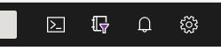
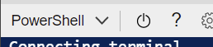
Step 0 – Initialize Cloud Shell
Execution:
Connect to the internet
Login to https://portal.azure.com
Start Cloud Shell (select or create a storage account if prompted)
Ensure Cloud Shell is set to PowerShell
In the cloud shell run Connect-AzAccount -UseDeviceAuthentication and follow the instructions. Login using your Azure Portal credentials
In Cloud Shell run the following to download the workshop files (IWR aka.ms/1).Content | IEX A warning about the subscription ID will be shown, we’ll fix this next
NOTE: The Cloud Shell is where all workshop
PowerShell scripts should be deployed.

Slide 9
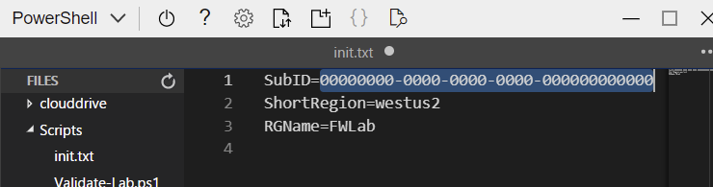
Step 0 (cont) – Update init.txt
All scripts pull critical information from the init.txt file, so it’s important to update this file to reflect the resource group name and subscription you’ll be using for this deployment of the firewall workshop.
Execution:
Open the Cloud Shell editor (red circled icon)
Navigate to init.txt (red boxed item in file hierarchy)
In the right-hand pane, update the Subscription ID to your Subscription ID and optionally the RGName to use the resource group name you wish to use inside your subscription.
Once updated, press CTRL+S to save the init.txt file.
Rerun the validation script, ensuring no errors and that the File Variables are as intended. ./Scripts/Validate-Lab.ps1
NOTE: In the init.txt file there
must be no quotes or spaces

Slide 10
Step 1
Execution:
Change to the Scripts folder cd Scripts
(Optional) in the editor pane you can select and view the script before running
Run step 1 with the following: ./WorkshopStep1.ps1
Validation:
Browse to your Resource Group in the Portal
You should see a Key Vault resource
Export the Key Vault, and the secrets therein
Take Away:
You now have a Resource Group in Azure to which you can now deploy resources!
NOTE: The Key Vault secrets contain
the Username and Password for
the VMs we will create today!

Slide 11
Step 2
Execution:
In the Scripts folder run ./WorkshopStep2.ps1
(Optional) in the editor pane you can select and view the script before running
Validation:
Browse to your VNet in the Portal
Review the subnets
You should see three subnets
Take Away:
You now have a network in Azure to which you can now deploy resources!
NOTE: You may see “warnings” from PowerShell about upcoming changes. These warnings do not affect running of the scripts.
Notes:
Although the VNet is referred to as a “Hub”, it is no different than any other VNet, “Hub” is just a distinction for how we intend to use the VNet later.

Slide 12
Step 3
Execution:
In the Scripts folder run ./WorkshopStep3.ps1
(Optional) in the editor pane you can select and view the script before running
Validation:
Review the VM components
(optional) RDP to the VM’s Public IP using the User01 password from the Key Vault secret
Take Away:
You now know how to deploy a simple, publicly accessible VM into a VNet in Azure.
Notes:
Jump VM refers to how we intent to use the VM, Jump server – Wikipedia. While we won’t use this as an actual Jump VM today, we will show how connectivity is cut off from the Internet once the Firewall is deployed.

Slide 13
Step 4
Execution:
In the Scripts folder run ./WorkshopStep4.ps1
(Optional) in the editor pane you can select and view the script before running
Validation:
In the portal, pull up the Firewall
Review the properties, especially the Rules section.
Try RDPing to your Azure VMs public IP, because we don’t have a rule for that, it will fail.
Take Away:
You just protected your resources from the Internet.

Slide 14
Step 5
NOTE: When browsing today
be sure to use HTTP,
not https. I’m too
lazy to create certs.
☺
Execution:
In the Scripts folder run ./WorkshopStep5.ps1
(Optional) in the editor pane you can select and view the script before running
Validation:
In the portal, pull up the Firewall
Review the Rules section.
From a browser hit the public IP of the firewall (it will NAT to the IIS server and provide a web page)
Hit the private IP of the IIS server (the firewall network rules should allow the page to be visible)
Take Away:
You just deployed your company’s first web site!

Slide 15
Step 5 (cont)
Execution:
Turn on and review monitoring
In the portal open the firewall
Click the “Diagnostic settings” tab
Click the “Turn on diagnostic” link
Name your setting “Firewall-Logs”
Check “Send to Log Analytics”
Select your Company’s workspace
Check both log types and save
Validation:
In your Resource Group open your “Log Analytics workspace”
Open the “Logs” tab
Review the slide notes below to see some example queries
NOTE: It may take up to 10
minutes for logs to
begin flowing into
the log workspace.

Slide 16
Final
Review these additional features in this deck:
Virtual WAN
Load Balancing Overview
Global: Azure Front Door
Global: Traffic Manager
Regional: Application Gateway
Regional/Local: Azure Load Balancers
Azure DNS

Slide 17

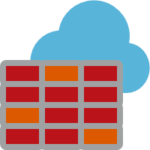

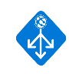

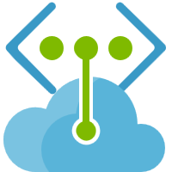


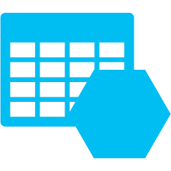
Virtual Networks
Your virtual private network in the cloud
10.1.0.0/16
Private isolated logical network
Supports Network ACLs and IP Management
User defined routing for network virtual appliances
Extends on-premises network to the cloud
Provides secure connectivity to Azure services
UDR
Internet
On-premises
Azure Services
“User Defined Routing (UDR) allows customers to easily secure their lift-n-shift and cloud-native applications in Azure using next-generation firewalls like VM-Series.
This includes micro-segmentation in an Azure VNET and securing Azure applications at scale with VM-Series instances behind the Azure Standard Load Balancer.”
Jigar Shah
Product Line Manager, Palo Alto Networks

Slide 18


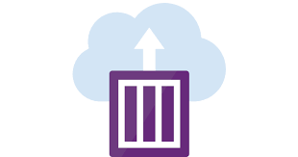
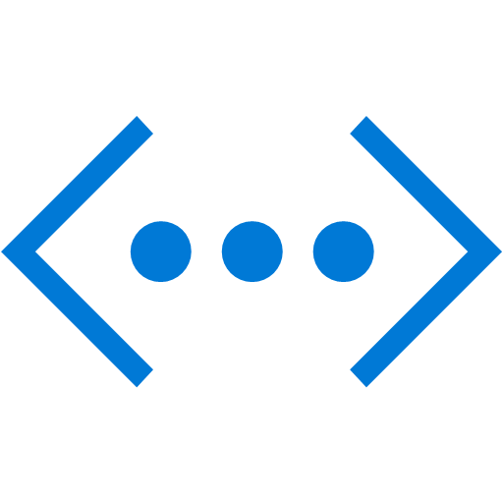

Extending VNets to Containers
VNet 10.1.0.0/16
AKS subnet
Containers are first class citizens
Containers ..
Deploy containers into your VNet using Azure CNI plugin
All VNet and security policies apply to containers (like VMs)
Azure Kubernetes Service (AKS)
Azure Container Instances (ACI) can now be deployed into your VNet (Preview)
C1
C2
C3
Azure CNI
10.1.1.4
10.1.1.5
10.1.1.6
ACI subnet
NEW!
Azure CNI
10.1.2.4
10.1.2.5
“AccuWeather’s decision to utilize Azure CNI was around the ease of connecting our AKS Clusters in various regions using VNet peering. This also provided the option to use ExpressRoute to facilitate local network connection”
Doug Honikel
Vice President, Software Development
Notes:
To learn more go to BRK3294 – 9/26 12:30PM

Slide 19

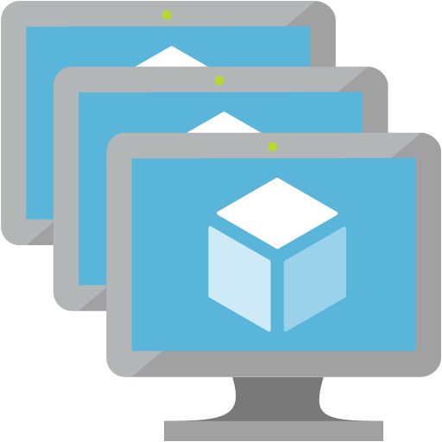





Virtual Network
What’s new
Public IP Prefix
Service Endpoint Policies
A reserved IP range for your public endpoints in Azure
Simplify IP address management
Predictable, contiguous public IP addresses
One CIDR block to give your customers for whitelisting
Enhanced VNet security for Azure services
Prevent access of unauthorized Storage accounts from VNet
Restrict Vnet access to specific Storage Accounts
Granular access control
Azure
Internet
Public IP Prefix
VNet 1
Account A
X.X.X.1
X.X.X.X/27 Allow
SERVICE ENDPOINT
X.X.X.2
Internet Deny
X.X.X.3
X.X.X.4
Allow Account A
SERVICE ENDPOINT POLICY
X.X.X.5
Account B, …

Slide 20
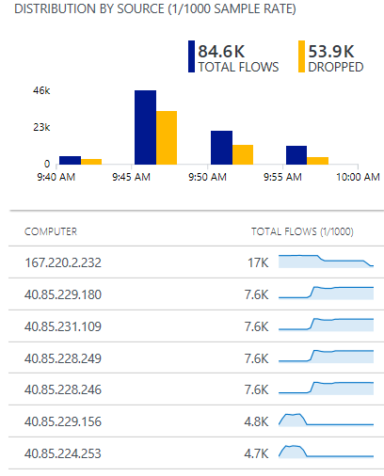
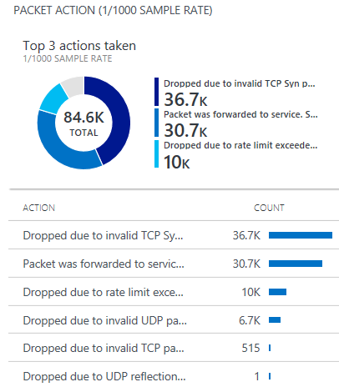
Azure DDoS Protection
GA
Cloud scale DDoS protection tuned to applications
Simple to provision for all your virtual network resources
Always on monitoring with near real time telemetry and alerting
Automatic network layer attack mitigation
Protection policies tuned to your application’s traffic profile
What’s new
DDoS Attack Analytics
Near real time network attack mitigation flow logs
Attack data snapshots and full post attack summary
DDoS Rapid Response
Specialized Rapid Response team support during active attacks
Custom mitigation policy configuration
Azure Security Center integration
Intelligent DDoS Protection virtual network recommendation
Attack flow logs Azure Log Analytics view

Slide 21
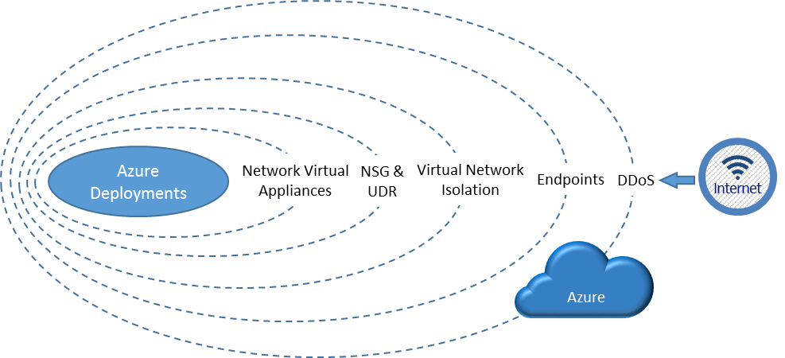
Visualizing layers of security

Slide 22
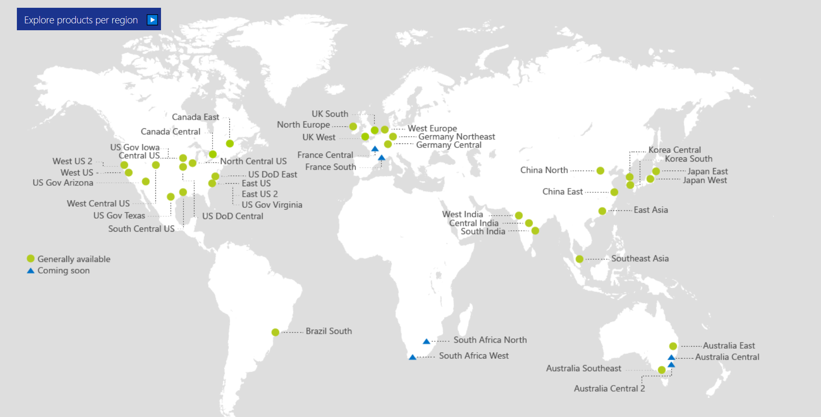
Also Announced:
Germany North
Germany West Central
Switzerland North
Switzerland West
Norway East
Norway West
UAE Central
UAE North

Slide 23
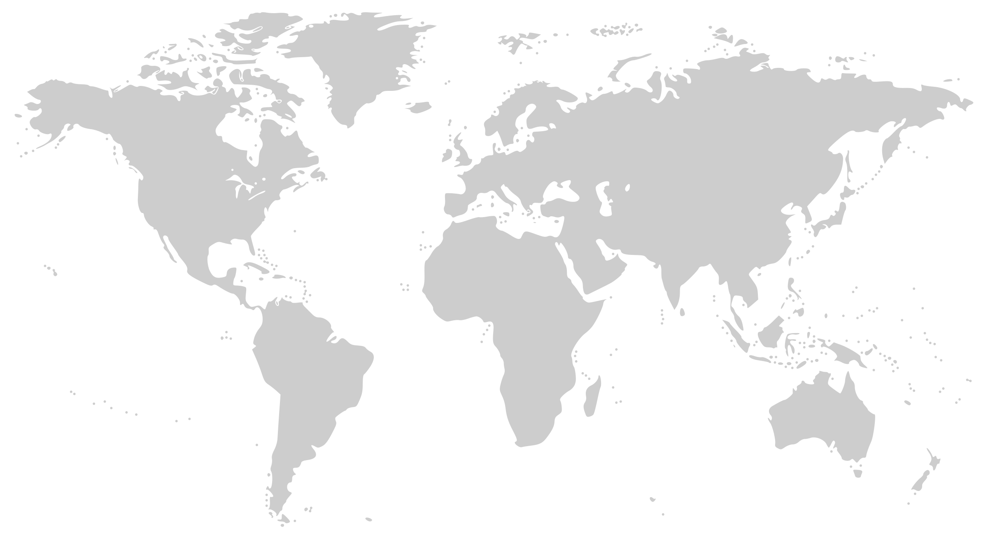
Microsoft Global Network
Greenland
Svalbard
United States
Sweden
Norway
Russia
Canada
United Kingdom
Poland
Ukraine
Kazakistan
Russia
One of the largest private
networks in the world
100K+ miles of lit fiber
130+ edge sites
8,000+ ISP sessions
44 ExpressRoute locations
200+ ExpressRoute Partners
SDN Managed (SWAN, OLS)
France
United States
Turkey
Algeria
Iran
China
Pacific Ocean
Mexico
Atlanta Ocean
Libya
Egypt
Saudi Arabia
India
Myanmar (Burma)
Mali
Niger
Chad
Sudan
Pacific Ocean
Nigeria
Ethiopia
Venezuela
Colombia
Dr Congo
Peru
Angola
Indonesia
Brazil
Zambia
Indian Ocean
Bolivia
Nambia
South Africa
Australia
Owned Capacity
Data center
Argentina
Leased Capacity
Moving to Owned
Edge Site
DCs and Network sites not exhaustive

Slide 24
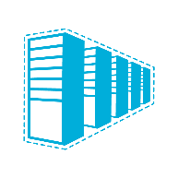

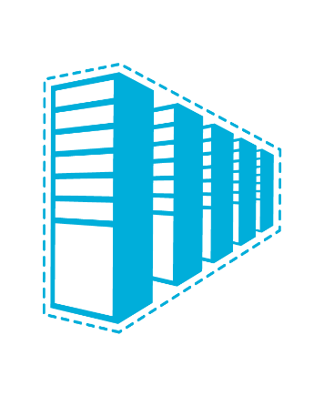


Connectivity options and hybrid offerings
Azure
Customer
Segment and workloads
Consumers
Access over public IP
DNS resolution
Connect from anywhere
Internet connectivity
Developers
POC Efforts
Small scale deployments
Connect from anywhere
Secure point-to-site VPN connectivity
SMB & Enterprises
Connect to Azure compute
Connect branch to branch
Virtual WAN and Site-to-site
VPN connectivity
SMB & Enterprises
Mission critical workloads
Backup/DR, media, HPC
Connect to all Azure services
ExpressRoute private connectivity

Slide 25





Azure ExpressRoute
Private connectivity to Microsoft
Predictable performance
Enterprise-grade resiliency and with SLA for availability
Large and growing ExpressRoute partner ecosystem
Customer’s Network
Partner Edge
Primary Connection
Microsoft Edge
Secondary Connection
ExpressRoute Circuit
Microsoft Peering for Dynamics 365, Azure public services (public IPs)
Azure Private Peering for Virtual Networks

Slide 26











































































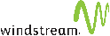



200+ ExpressRoute Partners

Slide 27

Azure ExpressRoute Direct
Announcing
Preview
10X
Breaking the speed barrier
Fastest of all cloud providers!
ExpressRoute Direct
100 Gbps direct to Azure
Built for customers with extreme bandwidth needs for massive data ingestion
Flexibility in bandwidth allocation
In-geo and global connectivity
ExpressRoute Peering Location

Slide 28
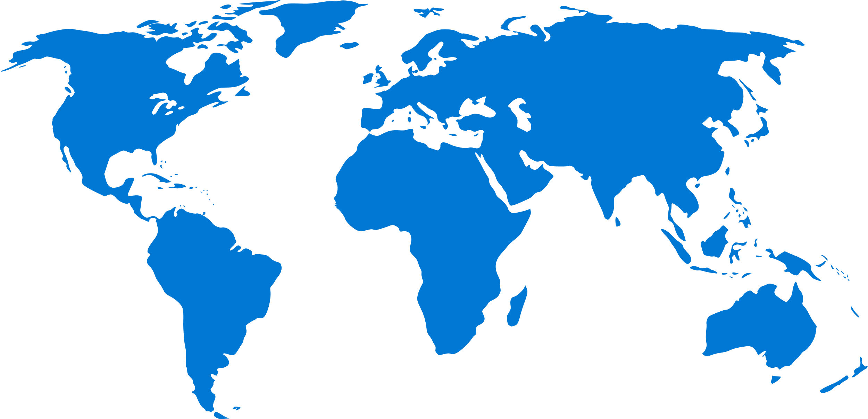

ExpressRoute Global Reach
Preview
Deploy global site-to-site connectivity using the Microsoft global network
On-demand connectivity between your sites using existing ExpressRoute circuits
Complements your service provider’s WAN solution
Traffic stays on Microsoft’s global network
Available in Public Cloud
U.S., U.K., Hong Kong, Ireland, Netherlands, Japan
Australia, Singapore and Korea coming soon
Available in US Government Cloud

Slide 29
Azure Firewall
Cloud native stateful Firewall as a service
A first among public cloud providers
L3-L7 Connectivity Policies
Spoke 1
NAT, Network and Application traffic filtering rules allows Inbound/Outbound access
Central governance of all traffic flows
Built-in high availability and auto scale
Network and application traffic filtering
Centralized policy across VNets and subscriptions
Complete VNET protection
Filter Outbound, Inbound, Spoke-Spoke & Hybrid Connections traffic (VPN and ExpressRoute)
Centralized logging
Archive logs to a storage account, stream events to your Event Hub, or send them to Log Analytics or Security Integration and Event Management (SIEM) system of choice
Central VNet
Spoke2
Azure Firewall
Spoke VNets
Azure to On-Prem traffic filtering
Traffic is denied by default
On-Premises
Notes:
Easily configure connectivity policies for all your resources using network & application (fully qualified domain name filtering) rules
Both inbound and outbound support and NAT (SNAT and DNAT)
FQDN Tags support (e.g. Windows Update, ASE) to allow easy rule creation
Deployed in a click; fully integrated with the Azure Platform

Slide 30
UDR

Slide 31
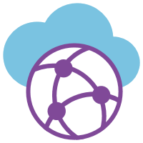
Azure Virtual WAN
GA
Easy deployment of large-scale branch connectivity
VNet
Branch to Azure, Branch to Branch
Automated provisioning and configuration
Scalability and high throughput
Large and growing integrated partner ecosystem
VNet
VNet
VNet
VPN
VPN
VPN
Internet
Region 1
Region 2
Region 3
Branch
Branch
Branch
Branch
Notes:
Mention traffic flow

Slide 32
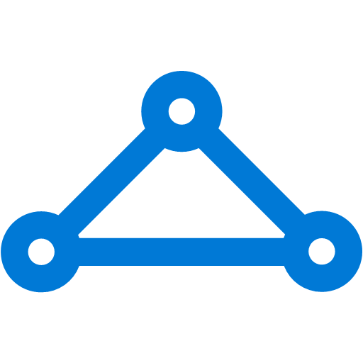




Azure Virtual WAN – Unified Cloud Connectivity
GA
Features
VNet
Hubs in Azure
Enable/disable branch to branch
IPsec IKEv1 and IKEv2
Scale unit-based billing
E2E Monitoring and Resource Health
ExpressRoute (Preview)
P2S with IKEv2 and OpenVPN (Preview)
O365 Policy (Preview)
VNet
Corp HQ
VNet
ExpressRoute
VNet
Datacenter
ExpressRoute
VPN
VPN
VPN
Internet
Region 1
Region 2
Region 3
Internet
Branch
Branch
Branch
Branch
Notes:
Branch office connect using Ipsec – see limits of 2 to 4 Gbps
For larger offices and DC you may need higher throughput OR locations that don’t have good Internet ExpressRoute is a good option.

Slide 33
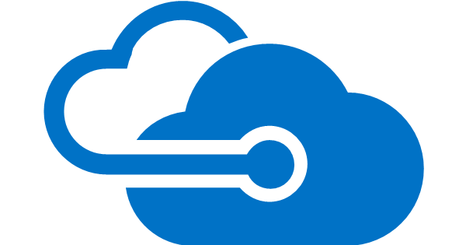
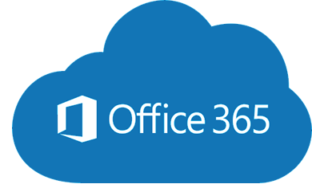




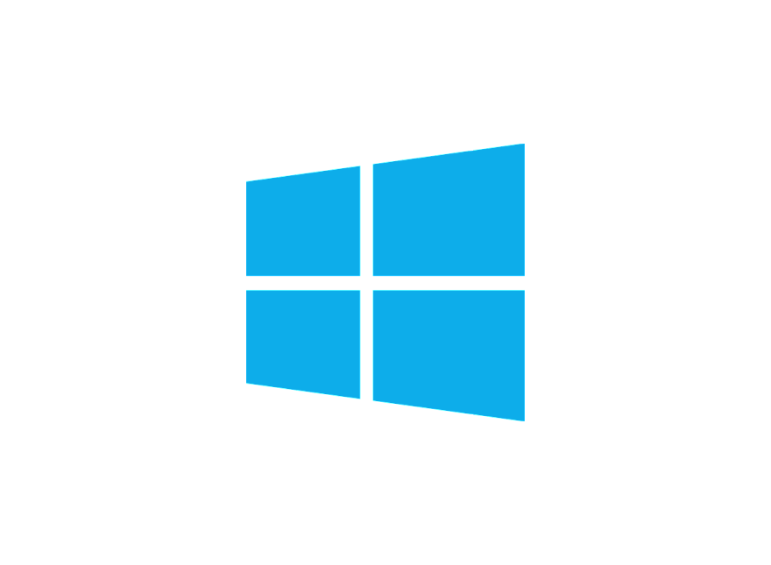
Traditional WAN
Azure vWAN
Azure
Azure
VNet
VNet
VNet
VNet
Internet
Branch
VNet
West US
vWAN
Hub
East US
vWAN
Hub
ExpressRoute
ExpressRoute
Carrier Network
(E.g.: BellC MPLS/SDWAN
SDWAN Controller
Console Connect
Biz Internet
(E.g. Bell/MAPS)
Carrier Network
(E.g. Bell MPLS/SDN)
VPN
VPN
S2S VPN/SDWAN CPE
P2S VPN/
User VPN
HQ/DC
Branch
Branch
Remote Users
Redmond
HQ Branch
Branch
Branch
Traffic Backhauled to HQ
Branch
Remote Users
Remote User

Slide 34

Azure Virtual WAN Partners
Coming soon
Notes:
Embracing a new era of distributed cloud connectivity
Talking points
We are excited by the partners who are available now with deep integration. In the Virtual WAN session you will learn more about their specific available now integration.
We also have an expanding set of coming soon partners who are working on integration. A top customer ask is when will Velocloud by Vmware be supported on Virtual WAN?

Slide 35



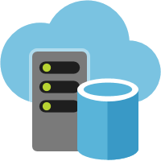
Azure Front Door Service
Preview
Your global entry-point to the cloud
Application acceleration
HTTP proxy at the edge of Microsoft’s global network
Reduce latency and improve throughput for your app
Scale out with massive SSL offload
Supports IPv6
Global HTTP/S load balancing
Active probing with global instant failover
Path based routing for microservices
Request rate limiting
Sticky, weighted and priority routing
Global insights
Central traffic dashboard
Regional backend health

Slide 36

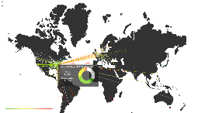




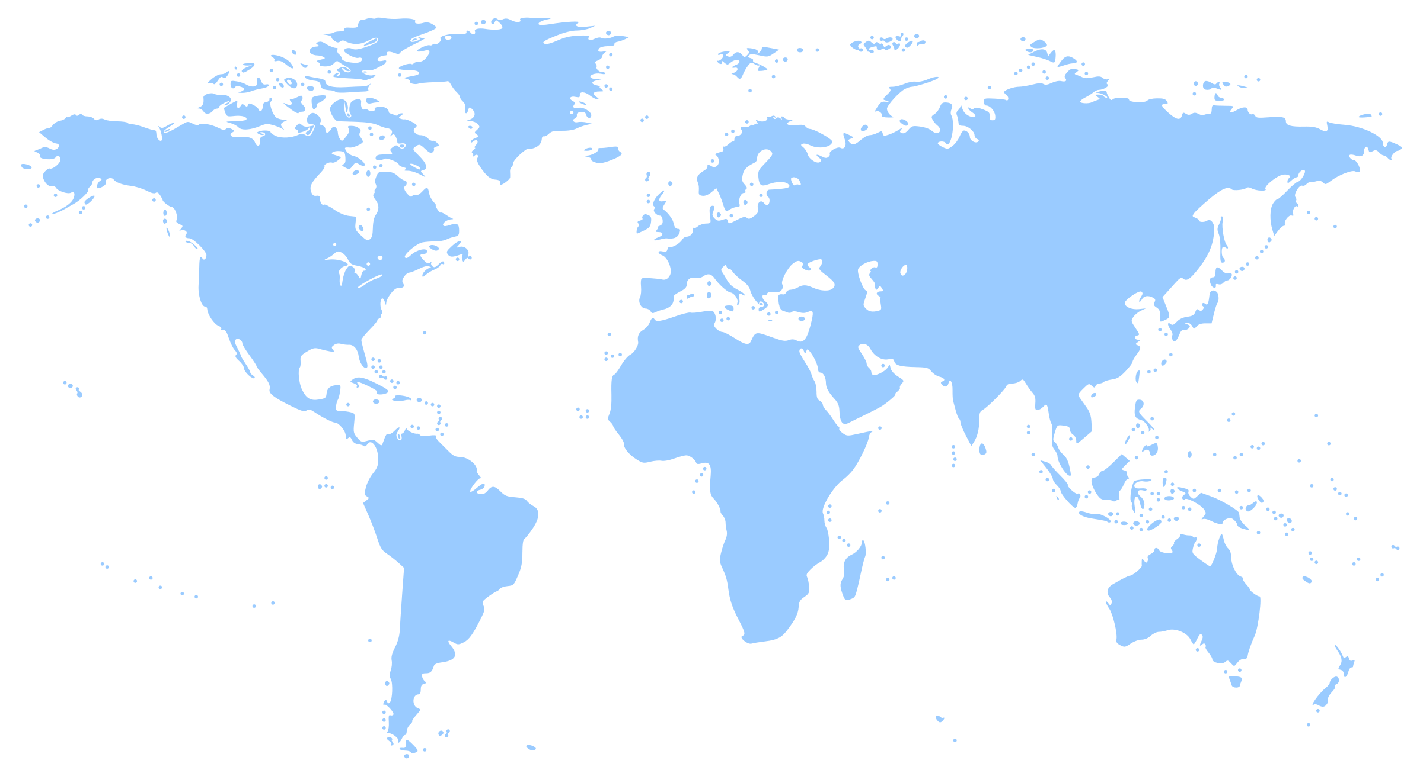



Azure Traffic Manager
Smart Traffic Engineering for Azure and external endpoints
Intelligent Routing
Geo, Subnet, Failover, Latency & Weighted
Traffic View
Actionable Insights
on real time data
Analytics and Logs
Identify patterns &
detect threats
What’s new
Add your endpoints using IPv4 / IPv6 addresses
Multi-value responses for increased availability
Route traffic to multi-tenant endpoints using custom headers
Specify custom HTTP response codes to indicate endpoint health
Subnet routing: Deliver customized content for ISPs or corporate offices

Slide 37



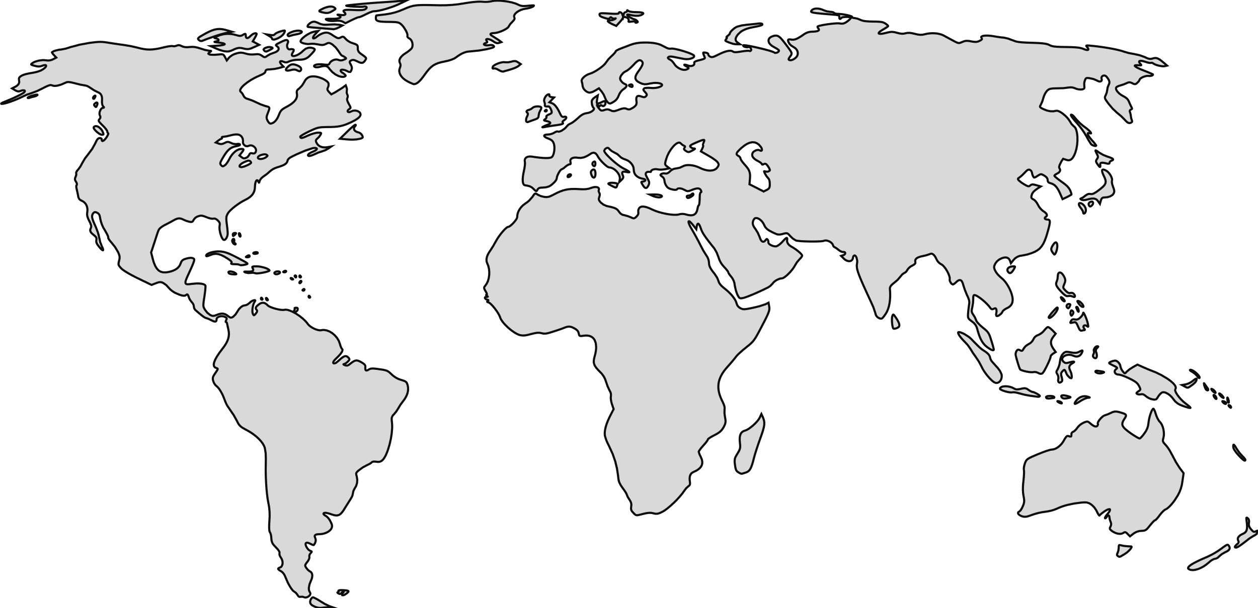




Load balancing in Azure
Preview
Application Gateway
Application Gateway
Front Door
Traffic Manager
Load Balancer
(Public)
Load Balancer (Internal)
Global
Region / Zone
Global
Regional
Internal
Route to your closest available service region or your on-prem DC. Offload SSL, improve performance / accelerate websites at the Edge.
Route across zones and into your VNET. Offload SSL and build your application-specific logic.
Route across and between your resources to build your regional application.

Slide 38



Application Gateway
Layer 7 load balancer for web applications
Platform managed built in high availability and scalability
Layer 7 load balancing URL path, host based, round robin, session affinity, redirection
Centralized SSL management SSL offload and SSL policy
Public or ILB public internal or hybrid
Rich diagnostics Azure monitor, Log analytics
What’s New
Features
Connection draining support
Custom error pages
Ingress Controller for Azure Kubernetes Service (AKS) preview
Diagnostics
Enhanced multi dimensional metrics
Diagnose connectivity issues with Network Watcher integration
Portal enhancements
Complete API Parity
SSL policy, VMSS, Web App Services, Custom error pages, Redirection, Connection draining
And more features …
Web App Service
Site 1
Internet
Application Gateway
Site 2
VPN
On-Premises

Slide 39
Application Gateway continued what’s new
Preview
Performance and scalability
Autoscaling
Grows and shrinks based on application traffic requirements
Reduce operating cost
Better performance 5X better SSL offloads
550 connections/sec with RSA 2048 bit key Certs
30,000 persistent connections
2500 HTTP req/sec
Faster provisioning and configuration update
75% reduction in provisioning time (~5 mins)
85% reduction in config updates time (~40 secs)
Enhanced resiliency
Built in Azure zone redundancy
Choose single zone or multi zone Application Gateway
Feature enhancements
Robust Application Gateway IP static VIP
More features upcoming (Key Vault integration, modify headers)
Static VIP
Min capacity
Scale out at load
AZ1
AZ2
VMSS
VMSS

Slide 40


Azure Load Balancer
Inbound
Outbound
Cloud native network load balancer
Built-in high-availability and performance
Inbound and Outbound
Public and Internal load balancing
Availability Zones
Flexible for all TCP or UDP applications
Any VM in a VNet
HA Ports for n-active resiliency
Health probe for TCP, HTTP, and HTTPS
Metrics in Azure Monitor
Multi-dimensional
3rd party integration
Health
Probe
AZ1
AZ2
VMSS
VMSS
VNet
Pool
SNAT ports
per VM
VNet
HA Ports for Appliances
VNet

Slide 41

Azure load balancer What’s new
GA
Define, scale, and tune your outbound NAT
configuration
IP
IP
IP Prefix
Timeout = 4 min
Outbound Rule 1
Outbound Rule 2
Timeout = 60 min
Pool-based outbound NAT
Declarative configuration
Configure outbound idle timeout & TCP Reset
Customer-defined SNAT port allocation
Simplify whitelisting with public IP prefix
No application changes required
Instant release for both server and client
Use on any rule
Pool 1
Pool 2
Configure SNAT ports per VM
Optimize application performance with
clean connection releases
Preview
TCP Reset
TCP Reset
Connection
Release
Idle timeout
Connection
Release
Notes:
Previously, customers couldn’t define the outbound translation explicitly. It was a result of the inbound load-balancing rule.
Now, customers can declare outbound NAT explicitly. M

Slide 42





Building for global scale
Web applications
Streaming, Gaming & Cross premises
Maximize global reliability and performance with cross-region and zonal redundancy.
Maximize availability of non http workloads globally OR migrate to the cloud across regional and on-prem resources for all protocols
Global
Preview
Front Door
Global
Traffic Manager
+
Regional
+
Application Gateway
Regional
& Internal
On Prem
+
Application
Front End
Load Balancer
Internal
Web Apps
API Apps
Functions
Mobile Apps
Logic Apps
Internal
Load Balancer
Application
Back End
Services

Slide 43




Azure CDN
Microsoft’s global multi-CDN ecosystem
“Our page load times are very low, and we're able to do it on a more powerful and scalable infrastructure that costs us 45 percent less.”
Kevin Lisota, Geekwire
Built-in multi-CDN
CDN made simple
Choose from multiple top global CDN providers
Few clicks to deploy, enable/disable on demand
Deep integration
Developer friendly
Automatically discovers other Azure services
Use REST APIs, CLI, PowerShell to manage CDN
“Our partnership with Microsoft Azure was critical in extending our reach to more people and more devices via cloud streaming than ever before.”
Eric Black, NBC Sports Group
Global scale
Integrated portal
Easily handle traffic spikes and heavy load, supports IPv6
Custom domain SSL, bring your own

Slide 44
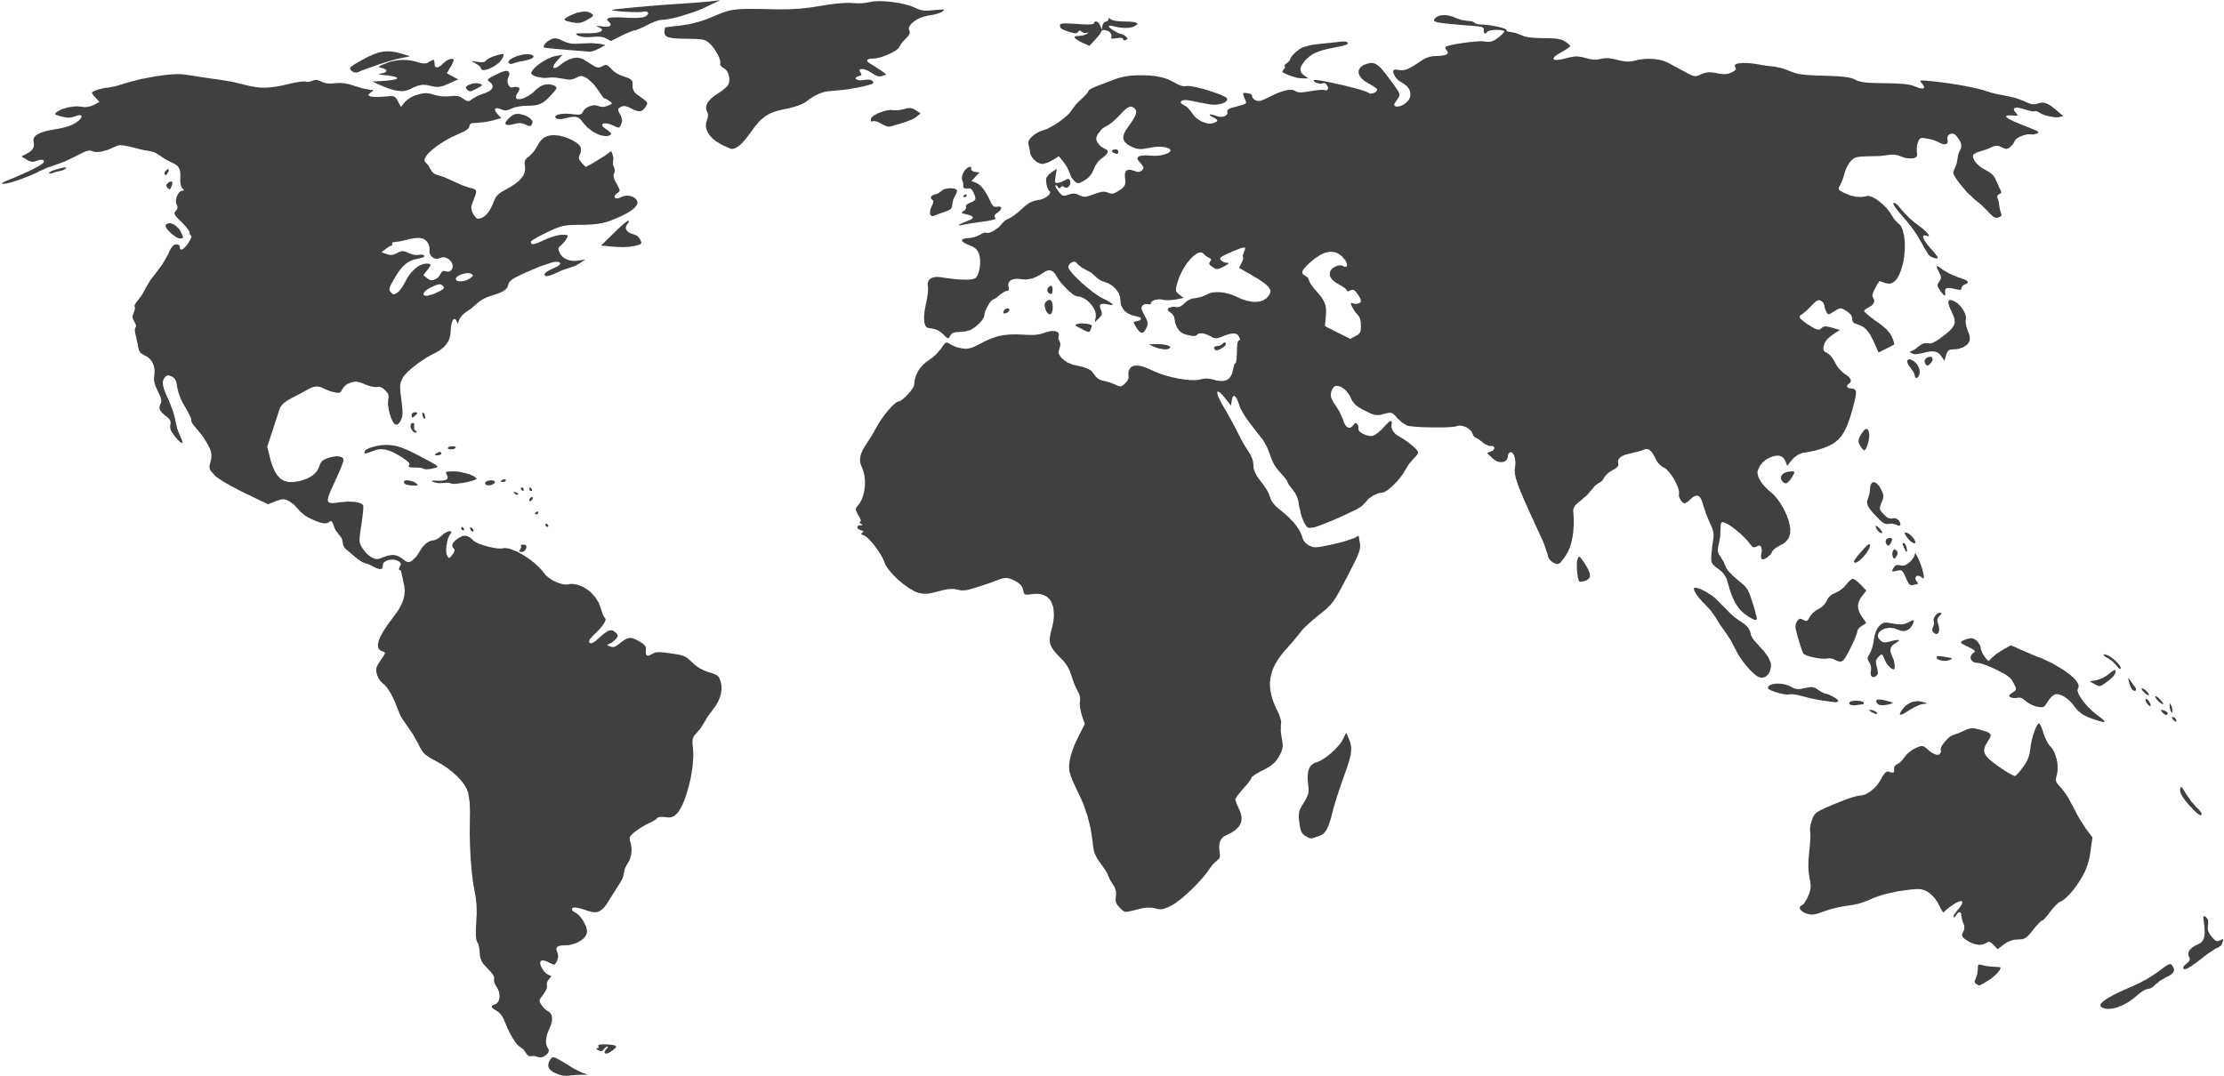
Azure CDN
GA
Cloud native CDN offering giving access to Microsoft global WAN
Azure Key Vault for custom certificates
Adding to Azure CDN’s choice of top CDNs
Mix and match CDN infrastructures
Increase global reach
Redundant CDNs for your service
CDN POP
Multiple CDN POPs
Regional Cache
64
GLOBAL
METROS
36
130+
COUNTRIES
EDGE SITES
and growing!
Notes:
Add bullet that lands “customer option”, “mix and match”
Add word “family”

Slide 45
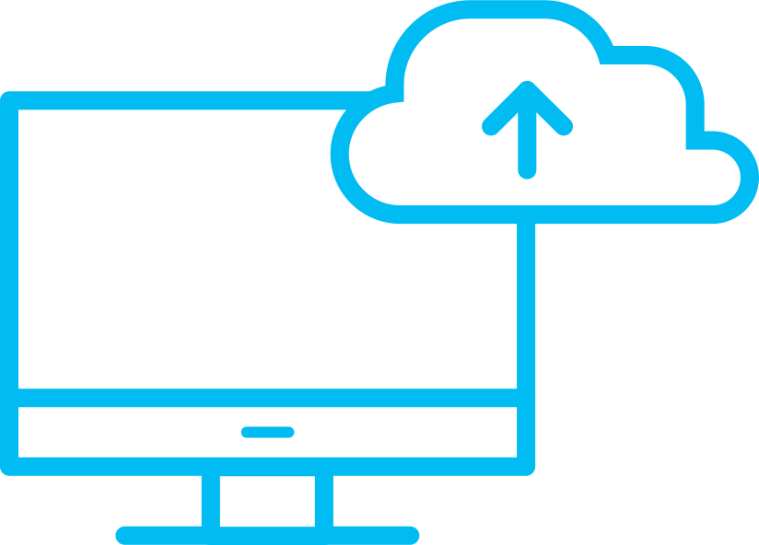
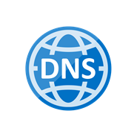
Azure DNS
Host DNS Zones with High Availability
100% Availability SLA
Reliability via Global anycast network
Our redundant data plane gives 100% reliability for your DNS zones.
Multiple nodes around the world advertise a given IP address providing reliable responses even in event of a node failure.
Announcing DNS Alias records
Keep your DNS records automatically updated when IPs change for your ARM resources.
Dynamic, instantaneous updates to your DNS zone ensures zero downtime for your applications.
Run a load balanced application directly at your Zone Apex by Alias to Traffic Manager, or any Public IP fronted service such as Application Gateway.

Slide 46
What we did today!
Business Problems Solved:
Contoso’s branch office Ops Personnel are connected to their Azure deployments.
Contoso has a web site in Azure that is secure in a modern architecture.
You should now be better able to…
discuss Azure Networking options in general
describe how virtual networks can be used, including VNet Peering
describe connectivity options from on-premises to Azure
know how to implement and configure Azure Firewall
understand and describe the three rule types associated with Azure Firewall
understand how to monitor and track events on the Azure Firewall

Slide 47
Thanks!!!
Please fill out feedback/comments for this session, your feedback is how these workshops get better.

